Slide 1
LoRA for Supervised Learning
By Alisha Rath
Presenting to Prof. Dr Chris Pollett

Slide 2
What is LoRA?
LoRA (Low-Rank Adaptation) is a method for fine-tuning large pre-trained models with a focus on reducing memory and computational costs.
It introduces trainable low-rank matrices into the model's architecture while freezing the original pre-trained weights.
Used for supervised learning tasks where labeled data is available.

Slide 3
Benefits of LoRA
Low Computational Cost: Reduces the number of parameters to train.
Efficient Fine-tuning: Works well with large models like GPT, BERT, and LLaMA.
Memory Efficiency: Decreases the memory footprint of model updates, making it easier to use on resource-limited devices.
Better Performance: Preserves the original knowledge of the model while adapting to new tasks.

Slide 4
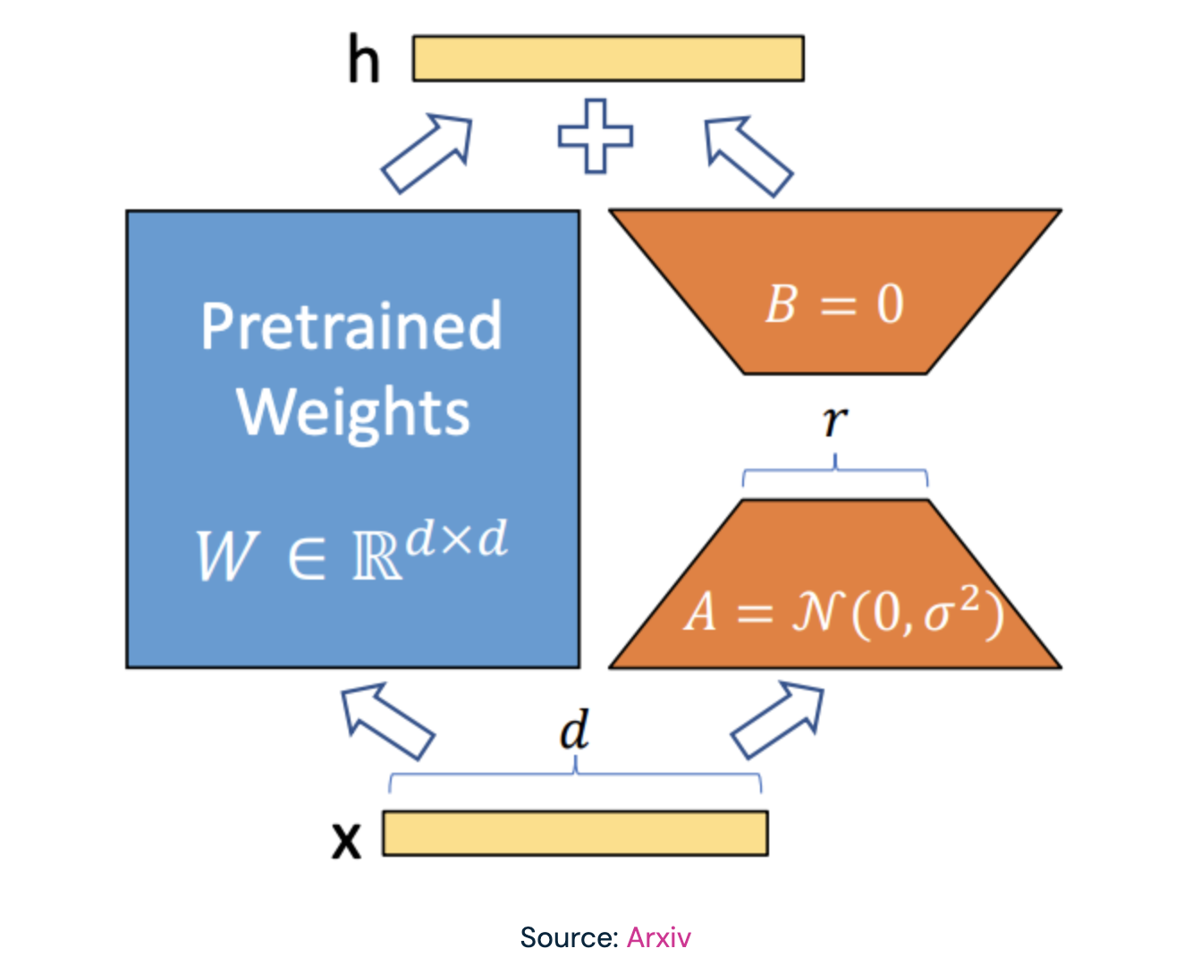
Mechanics of LoRA
Step 1: Original model weights are frozen.
1
Step 2: LoRA introduces two low-rank matrices, AAA and BBB, that are trained while keeping the frozen layers intact.
2
Step 3: The full model update is approximated by W+A×BW + A \times BW+A×B, where WWW is the original weight matrix.
3

Slide 5
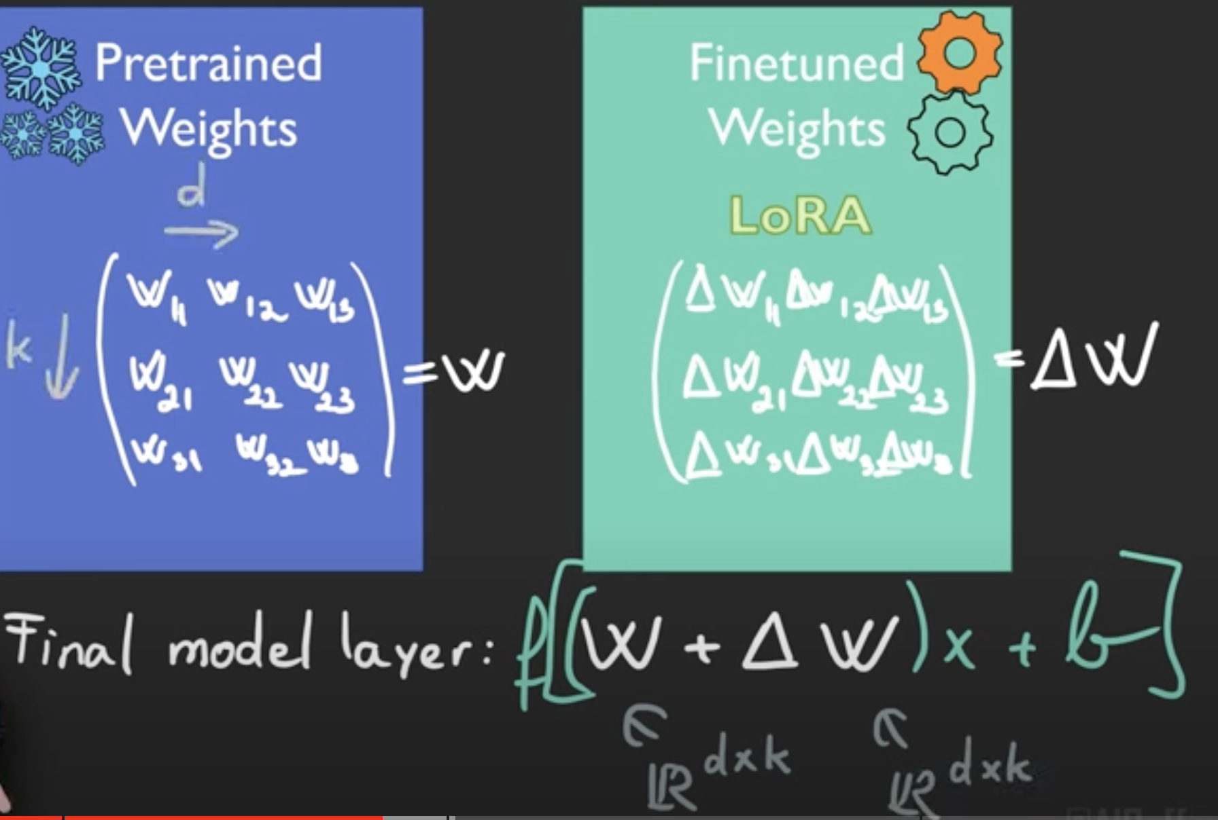

Slide 6
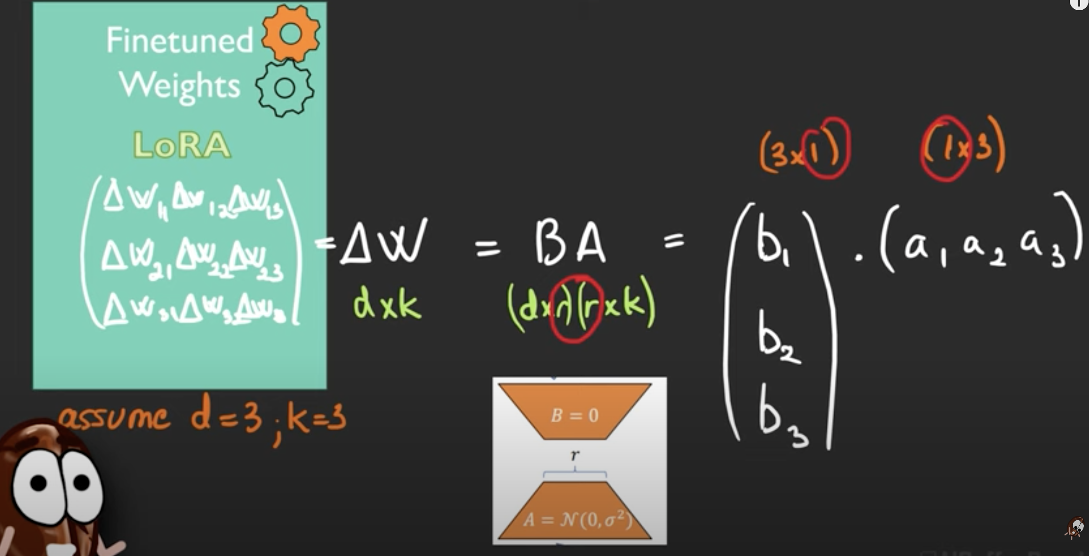

Slide 7
Application in Supervised Learning
Supervised Learning Basics: Learning a function from input-output pairs using labeled data.
LoRA's Role: Enables fine-tuning of large language models (LLMs) on specific datasets for classification, regression, or NLP tasks with less computational overhead.
Example: Fine-tuning a model for legal document classification using LoRA.

Slide 8
Steps in LoRA-based Supervised Learning
Load Pre-Trained Model: Start with a pre-trained LLM (e.g., GPT, BERT, or LLaMA).
1
Introduce Low-Rank Matrices: Insert LoRA modules into the model’s attention layers.
2
Freeze Original Weights: Keep the main model weights frozen to retain prior knowledge.
3
Train LoRA Layers: Train only the introduced low-rank matrices on the labeled dataset.
4
Evaluate: Test the fine-tuned model on the task-specific dataset.
5

Slide 9
Why LoRA is Superior
Memory Usage: LoRA uses significantly less memory compared to full fine-tuning.
Speed: Reduces time required for training.
Scalability: Allows the training of massive models without requiring specialized hardware.
Task Adaptation: Easier to adapt a general-purpose model to new specific tasks.

Slide 10
LoRA in Natural Language Processing
Text Classification: Fine-tune models for text classification (e.g., sentiment analysis, legal case classification).
Summarization: Improve document summarization tasks by fine-tuning on task-specific datasets.
Question Answering: Adapt LLMs for domain-specific question-answering with low memory and computational requirements.

Slide 11
Challenges with LoRA
Model Complexity: While LoRA is efficient, fine-tuning large models still requires significant resources.
Specialized Datasets: Performance heavily relies on the quality and size of the labeled dataset used.
Evaluation: Ensuring accurate evaluation metrics for new tasks is crucial.

Slide 12
Key Takeaways
LoRA offers an efficient, scalable solution for fine-tuning large models on specific supervised tasks.
It reduces memory and computational costs without sacrificing model performance.
Particularly useful for resource-limited scenarios in NLP and other machine learning domains.

Slide 13

Thank you

